Slide 1
.Net Standard with Xamarin
By Ken Tucker

Slide 2
What we are going to cover
What are Portable Class Libraries
What is .Net Standard
Using Entity Framework Core with Xamarin for Android
Using Entity Framework Core with Xamarin Forms

Slide 3
What are portable class libraries
First cross platform class library
Nice because you could use with windows, Xamarin, windows phone, xbox
Allowed you to use functions that are in all platforms

Slide 4
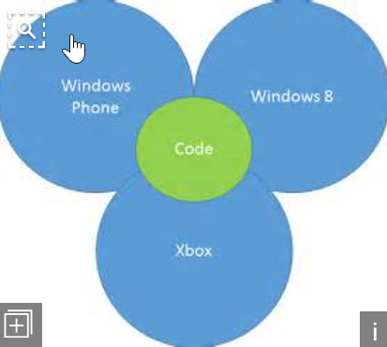
PCL diagram

Slide 5
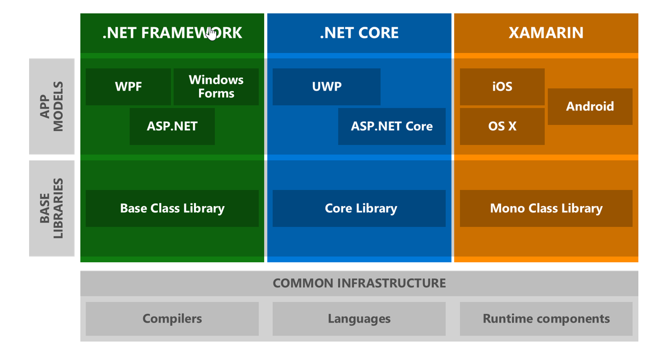
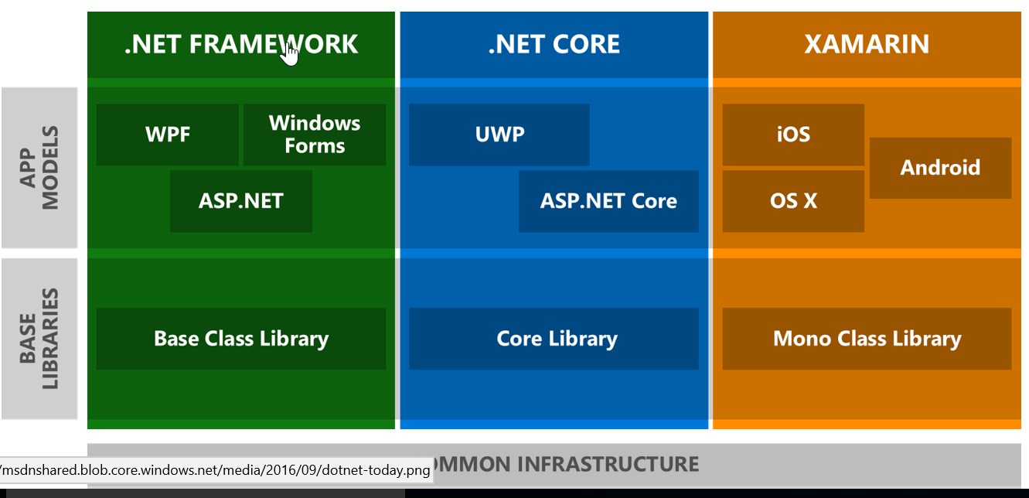
Why do we need Standard Libraries

Slide 6
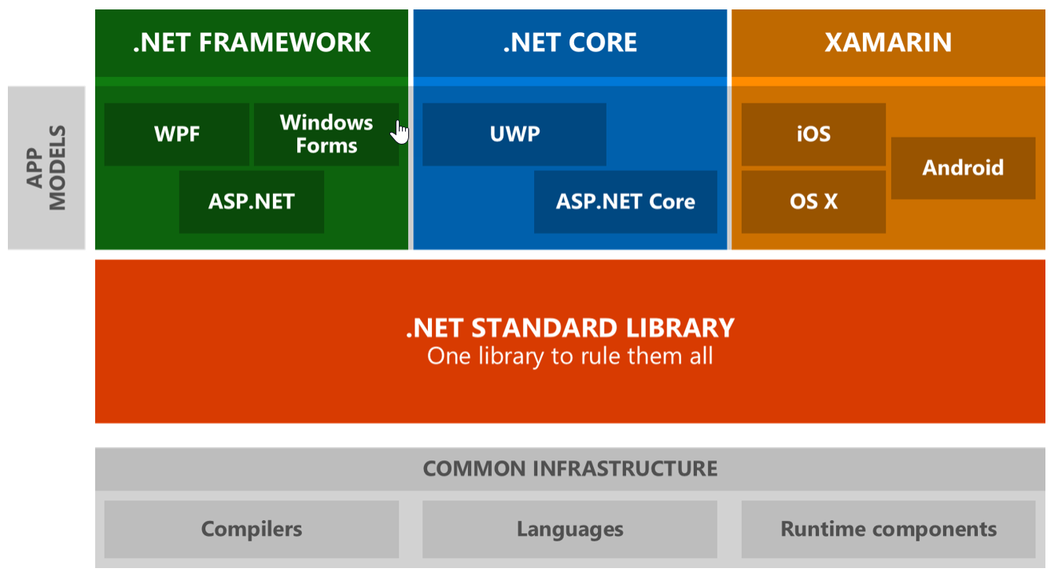
What are standard libraries

Slide 7
Continued
Standard libraries have same functions available in all platforms
Currently I am using .Net standard 1.3 in demos
.Net standard 2.0 will support more features

Slide 8
Add a standard Library to Xamarin Android
Create a new Xamarin Android project
Add a standard library
Add EntityFrameworkCore.Sqlite NuGet package
Add Class for table and data context
Connect and make sure table is created and add an item to
Show in a listview

Slide 9
Add to Xamarin forms
Create a new Xamarin forms project that uses a PCL
Remove NuGet packages
Change to standard library which targets 1.3
Update project.json
Add Xamarin forms NuGet package back

Slide 10
Add Entityframework core
Run project and make sure it works
Add Microsoft.EntityFrameworkCore.Sqlite NuGet package
Add classes for table and data context
Add FreshMVVM
Make sure Sqlite database is created at startup

Slide 11
Interact with the database
Add items to database
Update items in database

Slide 12
Resources
Sample code is on GitHub
https://github.com/vb2ae/AndroidEFDemo
https://github.com/vb2ae/XamarinFormsEntityFramework
https://docs.microsoft.com/en-us/dotnet/articles/standard/library

Slide 13
Ken tucker
Blog
http://www.onteorasoftware.com/
Twitter @vb2ae

